Slide 1
Modelling financial time-series data using a diffusion model.
By Sameer Dedge - 934295304

Slide 2
Table of Contents
Introduction
Background
Neural Networks
Generative Adversarial Networks
TCN
Denoising Diffusion Probabilistic Models
Gaussian models
Multinomial models
TabDDPM
Evaluation
Quantitative Analysis
Qualitative Analysis
Conclusion
References

Slide 3
Introduction

Slide 4
Introduction
Humans with biases, that are trading assets create intertwined and chaotic financial markets.
Asset prices in an established financial market are
“long” for large time scales.
Brownian for smaller time scales.
Large time scale strategies not always viable.
Lack of data coverage in smaller time scales.
Deep learning methodology unable to capitalize.

Slide 5
Introduction
Time-series data refers to data that has a notion of sequence in its structure.
Financial time-series data is referring to an asset that has value and the behaviour of that value throughout time.
Capturing the characteristics of the distribution of a financial time-series data is done using a deep learning models.
Generative Adversarial Model
Diffusion model

Slide 6
Why?
Modelling financial time-series data is an important topic of research in quantitative finance.
Allows to generate data points from financial distribution that can robustify regression tasks.
Can reveal stylized characteristics that can be further used in market anomaly or manipulation problems.
A perfect RL environment for a financial market would require modelling of assets traded in the environment.
Starting point?

Slide 7
Background

Slide 8

Background
Capital Markets
Stocks and Stock Options
Stocks - Tokens of publicly traded companies representing part ownership of the company.
Cannot access the revenues or profits of the company.
Value is realized by the stockholder after the sale of the stock.
Thus, relative return is modelled rather than the price of the asset.
where r_{t} is the return at time t and S_{t} is the current market price(or spot price) of the asset.

Slide 9
Background
Options - A financial instrument that acts as a contract between two parties (buyer and seller).
The option buyer, in exchange for paying the premium, gets the right(but not the obligation) to buy/sell the underlying asset at a fixed price(strike) on or before a fixed specified date(expiry).
The option seller, in exchange for receiving the premium, gets the potential obligation to sell/buy the underlying asset at a fixed price on or before a fixed specified date.
Two types of Options
Calls - The contract buyer has the right to buy the underlying asset at strike on or before expiry.
Puts - The contract buyer has the right to sell the underlying asset at strike on or before expiry.

Slide 10


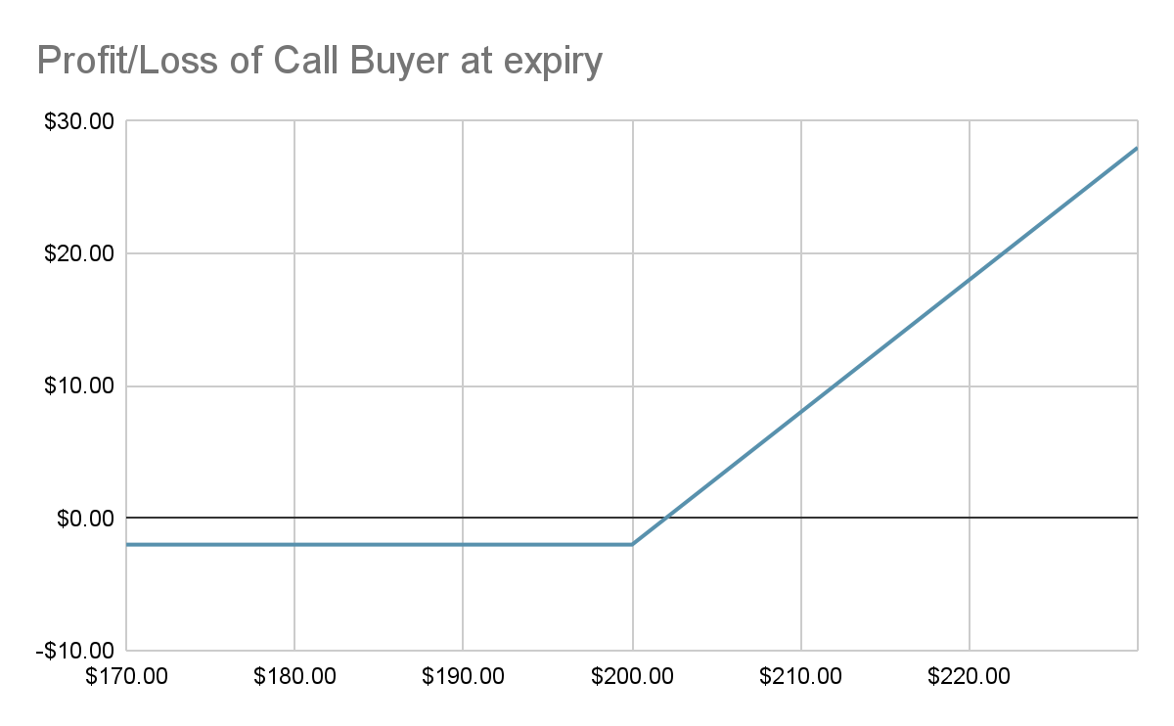
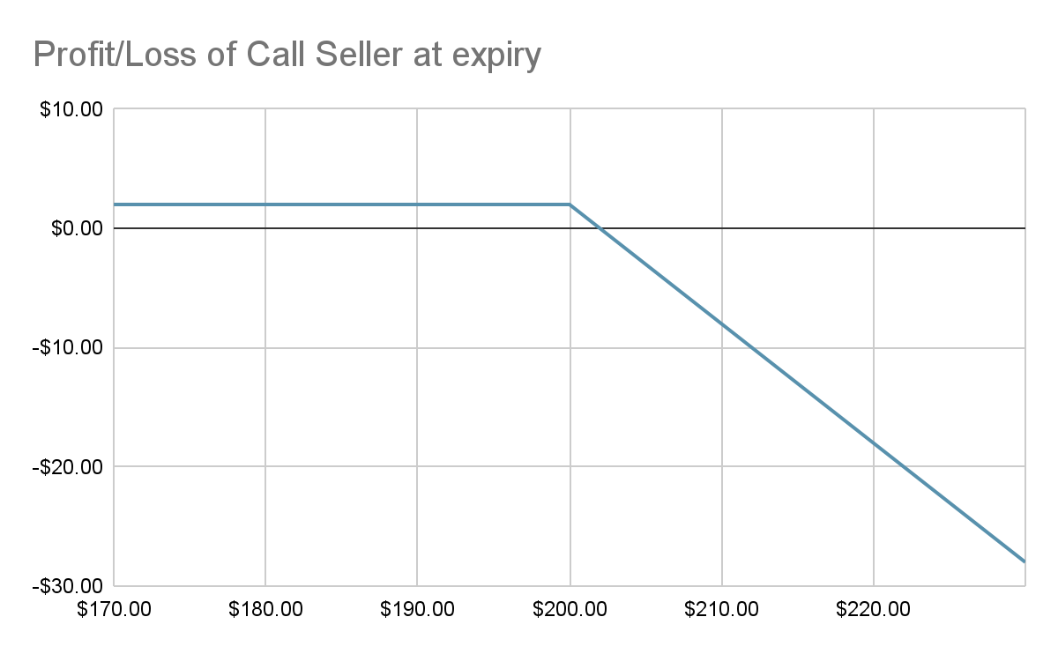
Options Call Example
NASDAQ: AAPL
$186.01
Person A
Person B
Person A buys an AAPL $200 call option for $2 premium expiring next month.
C_{b} = - Premium + Max(Spot-Strike,0)
C_{s} = + Premium - Max(Spot-Strike,0)

Slide 11
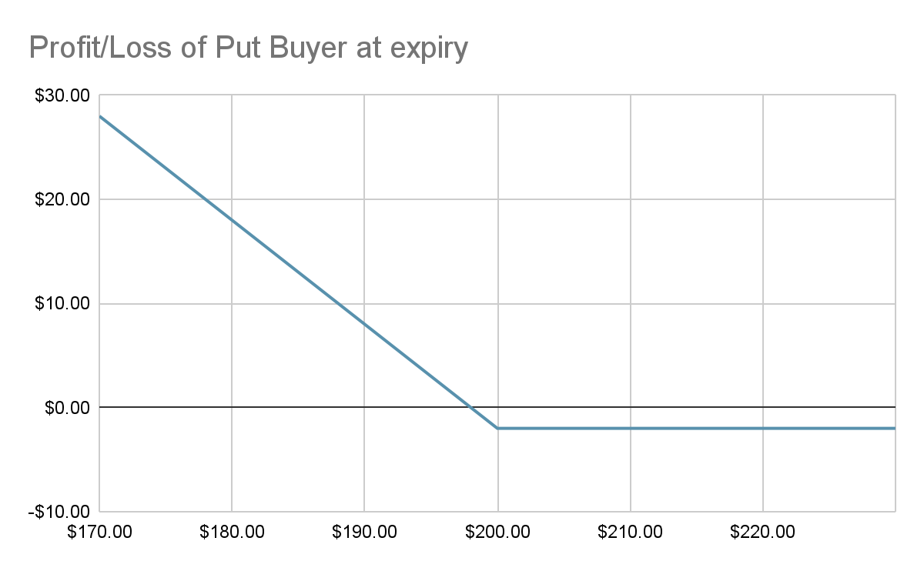
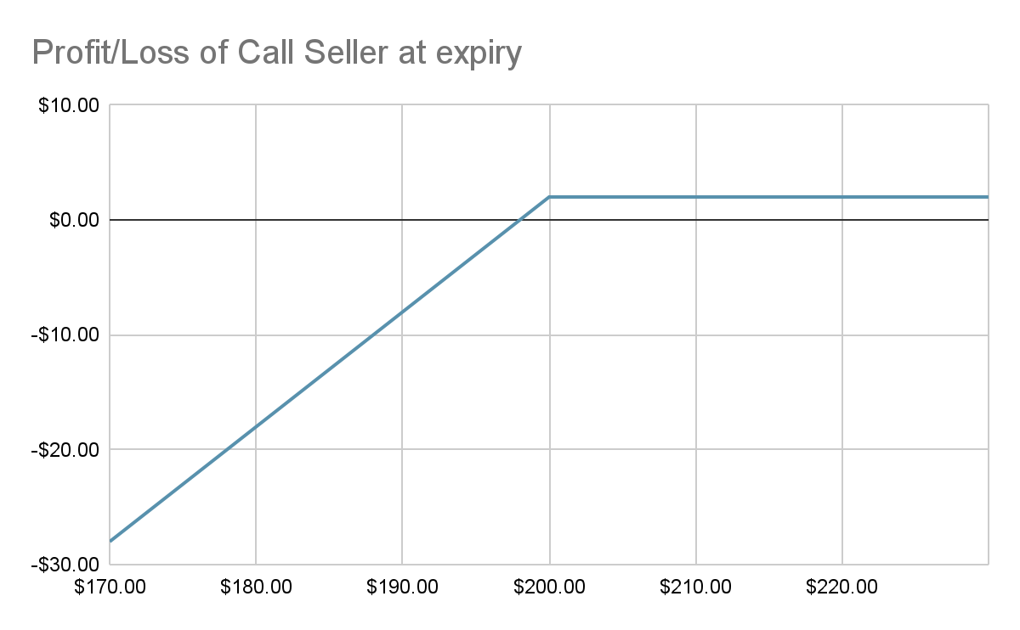
Options Put Example
NASDAQ: AAPL
$186.01
Person A
Person B
Person A buys an AAPL $200 put option for $2 premium expiring next month.
P_{b} = - Premium + Max(Strike-Spot,0)
P_{s} = + Premium - Max(Strike-Spot,0)

Slide 12
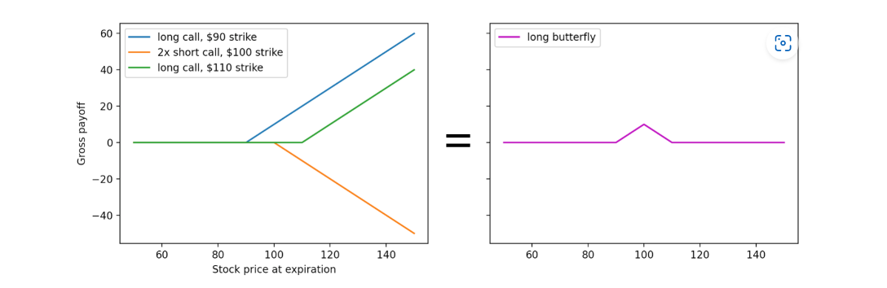

Option Distribution Modelling
Options are modelled after the probability implied in the payoff of options.
To model the probability, an artificial position called the butterfly spread is created.
Probability is calculated dividing the cost of the butterfly spread by the maximum payoff within the strikes of the butterfly spread.
Where, value of an option is given by C_{(K,𝜏)} with K strike and 𝜏 time to expiry T and ΔK as the maximum payoff from the strikes within the butterfly spread..

Slide 13
Neural Networks

Slide 14
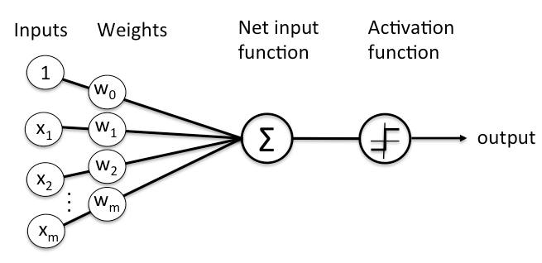
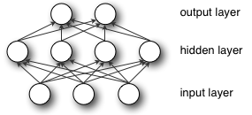
Neural Networks
Computational System, inspired from the human brain, that can learn complex patterns from data by adjusting their weights based on the “wrongness” or loss of the system.
It consists of nodes arranged in layers that take input, perform non-linear transformations and passes it to the next layer.

Slide 15
Neural Networks
Neural Networks are of the form:
where ⊙ is a composition operator, Φ is a non-linear activation function and f_{l} = Φ ⊙ a_{l}, with the learnable parameters of the network given by := (W(1), ... ,W(L+1),b(1), ... ,b(L+1)) as a_{l}: R_{l} → R_{l+1} takes the form a_{l}: x→ W^{(l)} + b^{(l)}.
Generating realistic and diverse samples from distributions is called generative modelling.
Generative modelling paradigm has 4 main types. The type and its use to model financial data is given below -
VAE : Dogaria et al.(2022) : No code.
GAN : Wiese et al.(2020): Baseline. Compared with diffusion approach.
Transformers: Fu et al.(2022) : No code.
Diffusion : No attempt found.

Slide 16
Generative Adversarial Networks (GANs)
The framework of GANs consist of two networks, a generative model pitted against a discriminative model.
Discriminator learns to determine whether a sample is from the real distribution.
Generator learns to fool the discriminator by generating samples resembling true distribution.
The GAN objective is given by -

Slide 17
GANs Continued …
Generator’s distribution p_{g} over data x is learned by mapping prior distribution over some noise p_{z}(z) to data space G(z; θ_{g}) where G is the differentiable function represented by a network with parameters θ_{g}.
Discriminator D(x; θ_{d}) outputs a single scalar D(x) that represents the probability of assigning the correct label to both real and generated samples from G.
Discriminator is trained to maximize log(D(x)) while the generator G is simultaneously trained to minimise log(1-D(G(z)))

Slide 18
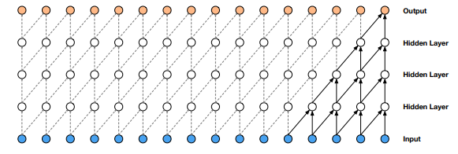
TCN GANs
Wiese et al.(2020) propose a modification to the GANs for the financial sector by replacing the multilayer perceptron by temporal convolutional networks.
TCNs consist of causal convolutions where an output at time t is obtained by convolving input elements from time t and before.
Causal connections require deep networks or large filters to cover effective past of the sequence.
Visualisation of a stack of causal convolutional layers with filter=2.

Slide 19
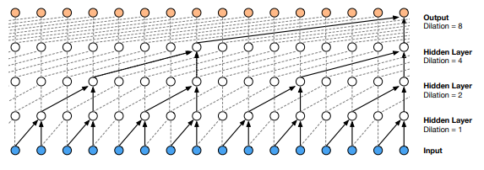
TCN GANs
Van den Oord et al.(2016) introduced dilated convolutions or convolutions with hole for longer sequences.
Dilated Causal Convolutions captures a large receptive field needed for sequence modelling.
TCNs used by the QuantGAN (Wiese et al., 2020) are made up of dilated causal convolutions.
Visualisation of a stack of dilated causal convolutional layers with filter=2.

Slide 20
TCN GANs
The GAN objective given previously -
becomes -
where D(x_{1:T}) and D(G(z)_{1:T}) are real and generated sequences respectively.

Slide 21
Denoising Diffusion Probabilistic Model
Diffusion models, are a class of latent variable generative models that are parameterised Markov chains trained using variational inference to produce samples matching the real data after a finite time.
The model consists of 2 Markov chains, a forward process that destroys the data to noise and a reverse chain that converts the noise back to data.
Forward Process q(x_{i}|x_{i-1}) uses data samples x₀ to to produce latent noise samples x₁, … , x_{T}.
Reverse Process parameterised by θ is given by p_{θ}(x_{i-1}|x_{i}) that gradually removes noise to generate the target distribution.

Slide 22


Gaussian Diffusion Models
These models work in continuous space and its forward and reverse processes are given by
The forward process converts the data sample x₀ into x_{T} which is a isotropic Gaussian while the reverse process learns to remove noise component ∊_{θ}(x_{t},t) through parameterised network.
Simplified objective of Gaussian diffusion models -
where α_{t} = 1 - β_{t}

Slide 23

Multinomial Diffusion Models
Type of diffusion models designed specifically for categorical data where x_{t}∊ {0,1}^{K} is a one-hot encoding of a categorical variable with K classes.
The multinomial forward process defines q(x_{t}|x_{t-1}) as a categorical distribution that corrupts data by adding uniform noise over K classes.
The posterior q(x_{t-1}|x_{t},x₀) can be derived as -
, where
The reverse distribution p_{θ}(x_{t-1}|x_{t}) is parameterized as q(x_{t-1}|x_{t}, x`₀(x_{t},t)) where x`₀ is the prediction from the network.
It is trained to maximize the variational lower bound -

Slide 24

TabDDPM
Kotelnikov et al.(2022) combines the multinomial diffusion process for categorical and binary features and gaussian diffusion process for numerical features.
The model takes input of dimensionality
,
where N_{num} is the number of numerical features and K_{i} are the number of categories each from x_{cat} categorical features.
Multinomial and Gaussian losses are added to get total loss.
The parameterised reverse diffusion process is learned by a fully connected neural network that has the output of the same dimensionality as input.

Slide 25
Evaluation

Slide 26
Evaluation
Financial time-series data should be evaluated quantitatively and qualitatively such that its stylized characteristics could be analysed.
There aren’t any established standard methods to evaluate generated financial time-series data.
Distributional metrics inspired from signal processing are used for Quantitative evaluation.
Wasserstein Distance
Kolmogorov-Smirnov test
Along with distributional metrics, we also evaluate the generated data on autocorrelation metric.
Autocorrelation is a degree of similarity between a given time series and its lagged version over successive time intervals..

Slide 27
Evaluation
Wasserstein distance is a measure of distance between 2 probability distributions.
It can be interpreted as minimum energy/cost of moving and transforming (a pile of dirt), one probability distribution to the shape of the other distribution.
Kolmogrov-Smirnov Test: K-S test quantifies a distance between the empirical distribution functions the real and generated sequences.
The pvalue of K-S test gives a probability that the two distributions come from the same underlying distribution.

Slide 28
Quantitative Results
 | QuantGAN(TCN) | TabDDPM | QuantGAN(TCN) - all_features | TabDDPM - all_features
EMD(1) ↓ | 8.033986e-04 | 4.403211e-04 | 5.904130e-06 | 5.106787e-06
EMD(5) ↓ | 2.058422e-03 | 1.818781e-03 | 1.400402e-05 | 1.559988e-05
EMD(20) ↓ | 1.072807e-02 | 8.936049e-03 | 8.636183e-05 | 3.617040e-05
EMD(100) ↓ | 1.269983e-01 | 2.054403e-02 | 6.638992e-04 | 5.630576e-04
K-S Test (p-value) ↑ | 42.455190% | 96.380698% | 52.053748% | 82.805256%
ACF(ᆞ) ↓ | 1.211521e-01 | 1.056656e-01 | 1.219926e-01 | 1.028182e-01
ACF(|ᆞ|) ↓ | 1.115744e-01 | 1.326045e-01 | 1.058974e-01 | 1.103400e-01
ACF((ᆞ)²) ↓ | 1.027946e-01 | 1.374898e-01 | 8.543895e-02 | 7.982600e-02
Leverage Effect ↓ | 1.310409e-01 | 1.083866e-01 | 1.239125e-01 | 1.275619e-01
ACF Score ↓ | 2.342331e-01 | 2.437218e-01 | 2.207953e-01 | 2.130510e-01

Slide 29
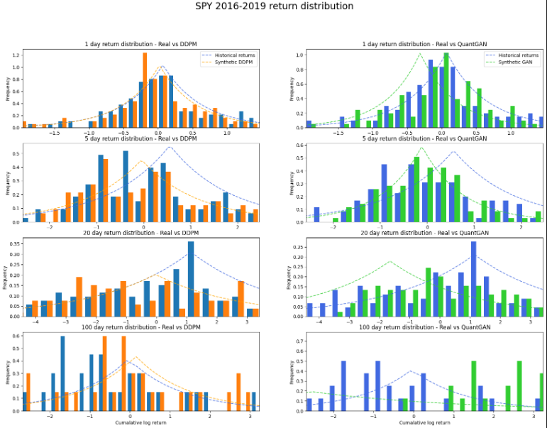
Qualitative Results
Heavy Tail Distribution - Empirical evidence shows that stock returns of an asset show heavy tail distribution.
TabDDPM is able to model heavy tails of returns a lot better than QuantGAN.
Peaked Distribution - QuantGAN is able to model preakness of the distribution but its mean is off which is not the case for TabDDPM on the 2 occasions it is matching with the peakness of real distribution..

Slide 30
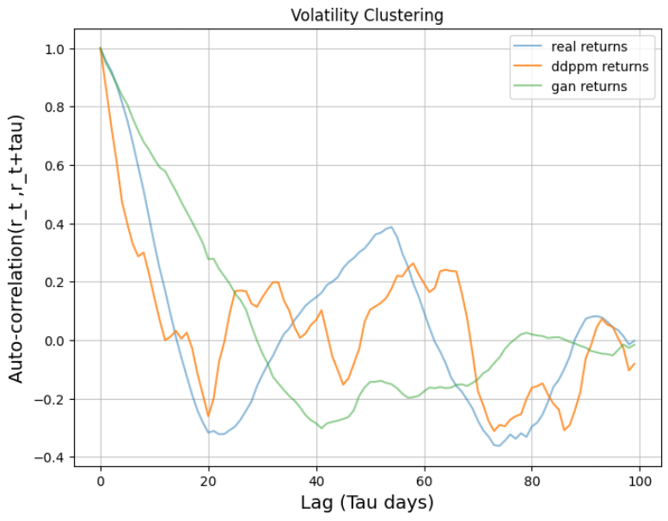
Qualitative Results
Volatility Clustering - Volatility clustering is the observation that large changes in price tend to follow large changes and small changes tend to be followed by small changes.
TabDDPM follows the correlation of volatility trend better than QuantGAN, even though it isn’t as smooth as the real distribution.
Thus, TabDDPM is able to model the volatility clustering effect which the QuantGAN is unable to.

Slide 31
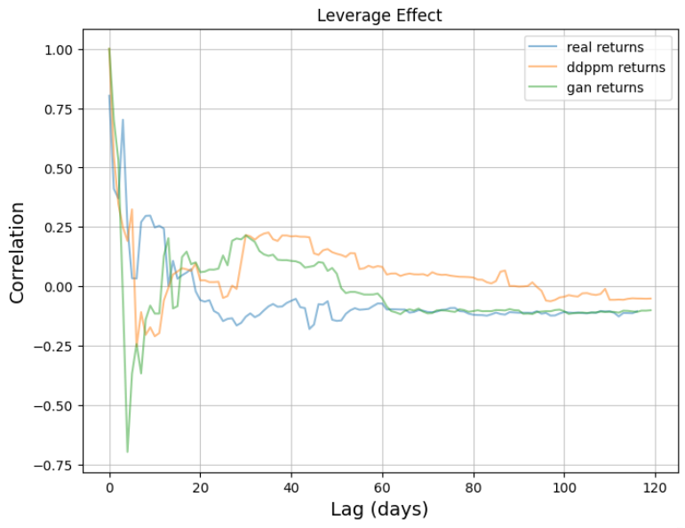
Qualitative Results
Leverage Effect - Volatility of an asset is negatively correlated with the return of the asset.
QuantGAN is able to to capture the effect very well which can be attributed to the long range dependencies modelling capabilities of TCN.
TabDDPM is unable to capture this effect. I wonder if it is due to the lack of a mechanism to deal with long-range sequences.

Slide 32
Conclusion

Slide 33
Conclusion
Generated distribution of TabDDPM performs better than QuantGAN at the Wasserstein distance metric and the K-S test indicating a superior structural modeliling of the real distribution.
QuantGAN, designed for sequential data, is able to capture the time-series correlation better than TabDDPM which is backed by the superior ACF score and the discussed qualitative analysis.
Different stylized characteristics are captured by different models so depending upon the use case, one should keep that in mind when using these models to generate data.
Further research needs to be done to see if TabDDPM architecture can benefit from modifications like TCN or attention mechanisms.
Finally, an alternative approach to model and generate financial time-series data is presented which is superior to the GAN approach in some cases.

Slide 34
Thank You

Slide 35
References
Dogariu, M., Ştefan, L. D., Boteanu, B. A., Lamba, C., Kim, B., & Ionescu, B. (2022). Generation of realistic synthetic financial time-series. ACM Transactions on Multimedia Computing, Communications, and Applications (TOMM), 18(4), 1-27. doi:https://doi.org/10.1145/3501305.
Fu, W., Hirsa, A., & Osterrieder, J. (2022). Simulating financial time series using attention. arXiv preprint arXiv:2207.00493. doi:https://doi.org/10.48550/arXiv.2207.00493
Wiese, M., Knobloch, R., Korn, R., & Kretschmer, P. (2020). Quant GANs: deep generation of financial time series. Quantitative Finance, 20(9), 1419-1440. doi:https://doi.org/10.1080/14697688.2020.1730426.
Oord, A. V. D., Dieleman, S., Zen, H., Simonyan, K., Vinyals, O., Graves, A., ... & Kavukcuoglu, K. (2016). Wavenet: A generative model for raw audio. arXiv preprint arXiv:1609.03499. doi:https://doi.org/10.48550/arXiv.1609.03499
Kotelnikov, A., Baranchuk, D., Rubachev, I., & Babenko, A. (2022). TabDDPM: Modelling Tabular Data with Diffusion Models. arXiv preprint arXiv:2209.15421. doi:https://doi.org/10.48550/arXiv.2209.15421.

